Slide 1


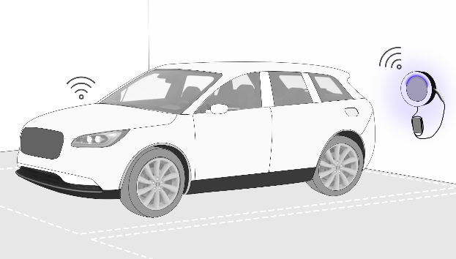
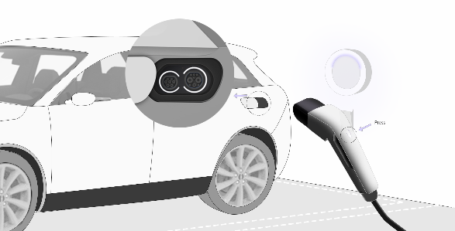
Wallbox Vehicle Communication
Ideation
Strengthen information communication, Smoother home charging experience
√
√
This feature is a key enabler for other feature like: Power charge door, auto-authentication, Wallbox embracement, Charge status sync, Wallbox OTA via vehicle.
A fundamental feature to build up effortless, seamless, and premium private charging experience for customer. It will also bring value for Ford charging operation and aftersales diagnosis.
-
√
Must to have enabled feature: auto-authentication, power charge door, Wallbox embracement, Charge status sync. Nice to have enabled feature: Wallbox OTA.
User driving towards his parking lot. Smart Wallbox lights up （and projects the Lincoln Star） in the parking lot to Welcome Albert.
Albert pushes the button on the charging coupler and pull it out. Wallbox light changes and Vehicle charging door opens also with lighting. Vehicle also light up and shows current SOC level via exterior lighting. Albert plugs the coupler into vehicle naturally.
After plugging in, Wallbox and vehicle light changes. Albert knows charging will be started soon.
CX821
Nio all series, Tesla all series, Zeekr 001.
√
√
CX821, CX771, CX748
√
√
√
2024

Slide 2
BRD – Product Category
Product Name
Product Team: Charging Products
Product Owner: Jiayu Zeng
Date: 05-30-2022

Slide 3
Content
Project Background
Business Purpose
Market/Competitive Analysis
Product Description
Sustainability Analysis
High-level Feasibility/Viability Check
Operations Needs & Impact
Risk Evaluation
Next Steps – Core Team

Slide 4
Project Background
New feature. Major customers in China living in multiple dwelling with their parking lot in open area. Therefore, their Wallbox (come with BEV for free) will be installed in open area exposing to all residents with branding image.
When customer parking its vehicle, Wallbox will wake up and welcome customer with lighting. Customer pull out the charge coupler/naturally press the S3 button on the coupler. The charge port door on the vehicle automatically opens. Customer plug the couple into the vehicle. Wallbox is unlocked and the charging automatically starts. Wallbox can potentially remind customer via lighting if SOC is too low.
Many parking lots underground or in remote location may have limited cellular signal for Wallbox. Vehicle can download Wallbox OTA package and transmit the package via this communication. (already realized by Tesla)
This feature can also provide more diagnosis information and charging data via Wallbox and vehicle synchronization. By doing this, charging features like Preferred Charge Time can be enhanced. And customer charging issue diagnosis can be much more efficient.
Leading Programs
CX821, CX771, CX748
Timeline
—— Dev Start: TBD
—— E2E Test: TBD
—— Release: CX821 J1

Slide 5
Business Purpose
Product Positioning（突出这次的优化项）
从无到有建立一个cross car line 的基础性充电功能
Business Target
有效实现车桩双向的近场可靠通信
通信内容可以使能多种充电功能场景及功能需求
Corporate Value
优化充电售后问题解决的数据基础

Slide 6
Market Analysis - Industry Trend
This is to describe the industry trend, to analyze and predict where the market is moving.
Trend 1
Major customer in China park their cars in open area of community. Excellent Wallbox can benefit Brand Promotion
Trend 2
Effortless and premium charging experience will be the next levels of worry-free charging.
…

Slide 7
Market Analysis - Customer Insight
Customer want effortless charging experience
Plug in and charge. Fast and easy.
Synced charging status provide better HMI.
Customer tend to show off premium experience feature
Good opportunity in open parking area
Customer want a worry free aftersales charging solution
Sync data can support better aftersales diagnosis capability

Slide 8
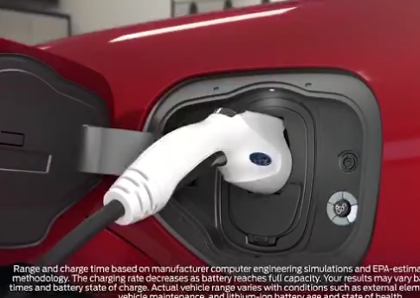
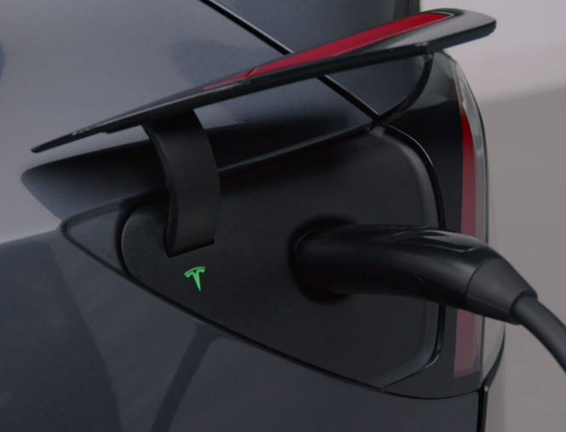
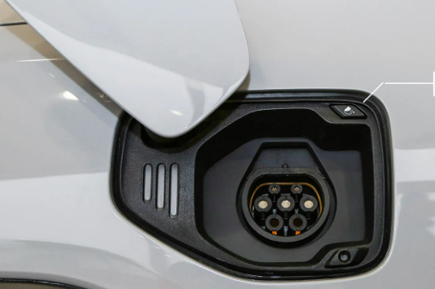
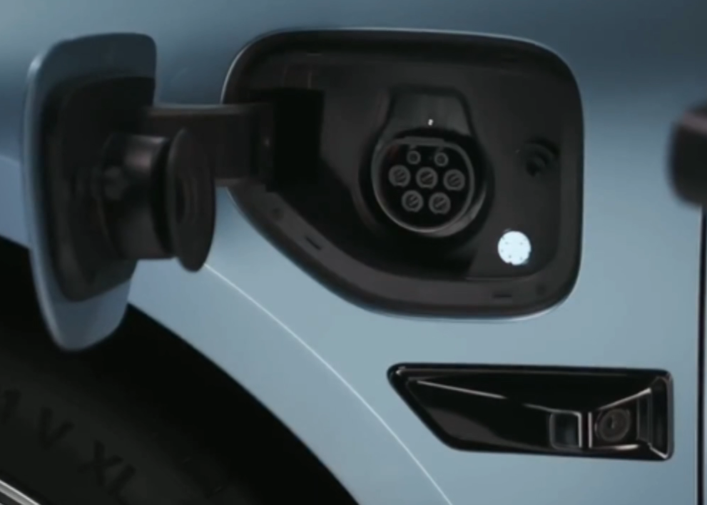
Market Analysis - Competitor Intelligence
 | CX727 | Tesla Model Y | Nio EC6 | Zeekr 001
Charge Port Door
Motorized Door via Wallbox |  | Y | Y | Y
Auto-authentication |  | Y | Y | Y
Wallbox OTA via Vehicle |  | Y

Slide 9










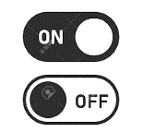
Product Description
1st Setup & Maintenance
How it works
CX727 As-Is:
First time charge at
Targeted places
(15mins or 1% SOC)
System record GPS/location
IVI Setting only:
1.Select history charging location
2. Set time period
3. Set Charging limitation specific for this feature
Arrived home and plug-in wallbox.
Make sure wallbox to be actived
Vehicle identify if target places or not.
If GPS identification is failed, then preferred charge time cannot be active.
Actual charging time calculation base on Target SOC. Do not meet customer expectation and cause confusion.
Charging at calculated time period which maybe earlier than ‘preferred time”
7 Steps
Expect to Be:
Strictly charging at preferred economical charging time.
3 Steps
Less complexity
More reliability
All Ford and Lincoln BEV users can easily Set preferred charging time per IVI or APP:
Set time period
Leverage universal charging limitation
Arrived home and plug-in wallbox.
‘Charge Now’
Skip preferred time for 1 time if need to charge right away, but do not change overall regular plan.

Slide 10










Product Description- Wallbox-Vehicle Comm Focus
Charging enabled
After plugging in, Wallbox and vehicle light changes. Albert knows charging will be started soon.
Go home with no worry
Driving back home
Albert knows he can focus on what to do tonight at home. Forget about the charging and leave.
Albert gets off work and drives his Lincoln car back home
On the road/
Preferred Charge Time
Remind to charge /
Auto-authentication ready
Parking with welcoming
Wallbox and vehicle unlocked for charging
Albert driving towards his parking lot. Smart Wallbox lights up （and projects the Lincoln Star） in the parking lot to Welcome Albert.
After Albert getting off the vehicle, Wallbox light changes (and speak up). Albert knows his vehicle and Wallbox has finished the handshake. .
Albert pushes the button on the charging coupler and pull it out. Wallbox light changes and Vehicle charging door opens also with lighting. Vehicle also light up and shows current SOC level via exterior lighting. Albert plugs the coupler into vehicle naturally.
Lincoln knows today is the day for charging. Lincoln ask for Albert’s confirmation if he needs to charge vehicle at home tonight from XX PM to YY AM .
If Albert confirmed, Preferred Charge Time will be automatically set.

Slide 11







Product Description-Some Potentials
Wallbox
User driving approach parking lot and park vehicle.
Binded Vehicle
Wallbox Embracement
- Light up for welcoming
Wallbox Embracement
- Illumination assist parking at darkness
Wallbox
User get off vehicle.
Binded Vehicle
Wallbox Embracement
- Vehicle SOC indication
Wallbox
User operate Wallbox.
Binded Vehicle
Auto-authentication
Vehicle Charging Error Log
Vehicle Embracement- Charging light
Effortless Charging - Power Charging Door
And other potentials…
Prefer charging time Embracement
- Vehicle setting and start charging time
Charge log Embracement
- Vehicle charging time
Charge level setting Embracement
Wallbox OTA through Vehicle

Slide 12
Product Description-Use Cases
1
设置车桩通讯
2
车桩通讯的选配使用1-灯光互动
3
车桩通讯的选配使用2-充电盖板打开
手机APP绑定激活车辆
并绑定家充桩开始设置车桩通讯
车辆驶入停车场与桩端连接蓝牙
校验通过
家充桩提示欢迎灯光
按家充桩枪头按钮
车辆充电口盖板打开/关闭
选择设置
校验
车桩密钥
迎宾灯
校验不通过
车辆停入车位打开车门
识别车辆
SOC
家充桩根据SOC 提示充电灯光
校验通过
4
车桩通讯的选配使用3-充电鉴权
整个车桩通讯打开成功每个单独功能可以关闭/打开管理
Plan B: 欢迎灯光即识别SOC 提示不同灯效
插入充电枪至充电口
桩立即开启充电或进入等待充电
开启至少
一个功能板块
选择不设置
识别车辆
插拔枪状态
家充桩提示车辆插枪/拔枪灯光
车辆识别到插枪/拔枪成功
关闭整个
车桩通讯
使用灯
5
车桩通讯的选配使用4-信息互动
插枪到拔枪
过程中识别
车辆故障
车桩蓝牙连接中车辆充电相关故障
家充桩提示车辆故障无法充电灯光
车辆故障信息
车辆插枪状态
车辆SOC
其他充电相关信息
家充桩无灯光互动
家充桩枪头按钮按无充电盖板打开
家充桩无车桩鉴权需刷卡或APP点击充电
家充桩无车桩信息的互动，桩端仅显示桩本身的信息数据
车给家充桩
车辆存在预约充电
识别车辆
充电设置
家充桩提示车辆等待充电灯光
车辆预约充电设置
车辆实际充电信息（开始结束时间，度数，时长）
打开上述功能体验需要进行新的一轮车桩通讯校验和设置
完成灯
识别车辆
SOC
家充桩提示车辆充电完成灯光结合SOC
家充桩给车
车辆完成充电
家充桩状态和故障信息
车桩鉴权的交互信息
车桩通讯设置和使用中信息
识别车辆
充电状态

Slide 13
Product Description-Feature List
MVP 实现
大场景 | 分场景 | 优先级 | 触点 | 备注
设置和管理车桩通讯 | 家充桩通讯密钥的管理 | M
 | 车辆通讯密钥的管理 | M
 | 车桩通讯的开通*APP | H
 | 车桩通讯总开关和子功能开关的管理*APP | H
基于车桩通讯的灯光互动 | 迎宾灯效-车桩蓝牙已连上 | H |  | 灯效由家充桩开发完成
 | 根据SOC提示充电灯效（电量范围高/中/低）提示开始充电和充电已完成 | L
 | 根据车辆插拔枪状态灯效 | L
 | 根据车辆故障提示灯效 | L
 | 根据车辆设置预约充电提示灯效 | M
基于车桩通讯的充电盖板打开 | 充电枪按钮按下打开车辆充电口盖板 | H
基于车桩通讯的充电鉴权 | 车桩在插枪时完成鉴权开始充电 | H
基于车桩通讯的信息互动 | 车辆信息传递给家充桩(充电相关故障信息、插枪状态、SOC、预约充电设置、车辆实际充电情况等) *APP | H
 | 家充桩信息传递给车辆（状态和故障信息、车桩鉴权信息、车桩通讯信息）*IVI | M
其他基于车桩通讯的拓展功能 | 车辆充电上限同步家充桩 | L
 | 家充桩借助车辆信号OTA | L

Slide 14



Product Description -Solution concept
Wallbox
Vehicle
Cellular
Module
IVI
Sync +
Digital Cloud Connection
Wallbox
BT
Module
Recognize user vehicle
Request seamless charging
Additional
BT
Module
/ Existing BLEM
Motorized
Charging Port
Provide Vehicle Identity
Respond seamless charging
Bluetooth Connection
Other existing vehicle module
EVSE
Charging
Sub-System
Vehicle
Charging
Sub-System
Legend
New Module
Existing Module
Power Transmission

Slide 15
Product Description -UX
我的家充桩主页
车桩通讯开通须知
信息校验
车桩通讯
车桩通讯管理
功能介绍
XXXX
个人信息告知
XXXXXX
前置条件提示：
已绑定车辆
已绑定家充桩
步骤1：车辆信息确认成功
步骤2：车辆信息密钥交换
车桩通讯总开关
开
关
开通成功！
3秒进入管理页面
车桩通讯功能入口
开通后可以获得以下体验：
车桩鉴权
开
关
电动盖板
开
关
信息互动
开
关
详情
返回
同意
灯光互动
开
关
详情
前置条件需要：
车辆已绑定且激活，家充桩已绑定
设置过程通过4G 云端/BLE 设置
若4G 需考虑桩端无信号如何处理
若BLE 需要考虑EVSS 云端校验密钥如何处理
灯光互动管理
迎宾灯
预约充电等待灯
故障灯
低电量需充电提示灯
取消
更改

Slide 16
Sustainability Analysis

Slide 17



High-level Feasibility/Viability Check
Lincoln Way App
Deliver wall box BLE meta data
Vehicle
Wall box
New BLE Module
[CAN message] Request to open charge door
Charging Door
Wall Box Vehicle Communication
Wall box BLE
Advertise with Beacon ID
Complete Sync+ onboard process
Scan QR code to add wall box
Bind / Unbind Wall box with vehicle
Advertise with Wall box BUUID
[CAN message] Request to read SOC
BMS
Wall Box SDK
Deliver vehicle BLE module Meta data
Initiate BLE connection
Within Power charging door Study Scope
Establish Secured BLE connection with wall box and vehicle BLE meta data
Vehicle BLE private key
Wall box public key
Get BLE key pairs linked to BUUID (from BLE module supplier)
BLE module private key written in supplier manufacturing plant.
BLE module provisioning
Stores wall box public key;
Request vehicle BLE and wall box meta data
Respond with wall box BLE and vehicle BLE meta data
Stores vehicle BLE meta data
Provisioning
Wall box info
Vehicle info
ECG
EVSS
Wall box cloud (3rd party)
Get wall box data
Get Vehicle data
Vehicle related cloud
Ford
New
Ford Existing Modify
Ford Existing No Change
3rd Party
New
3rd Party Existing Modify
3rd Party Existing No Change

Slide 18
Operations Needs & Impact

Slide 19
Risk Evaluation

Slide 20
Next Steps – Core Team

Slide 21
Thank You

